Slide 1
My first machine learning model(s)
Siddharth Agarwal
Data Scientist at Hopstack Inc.

Slide 2
Structure of workshop
The workshop has been divided into four sequential components.
Introducing the models and basic machine learning theory. (45 min)
Introducing the case you will be applying your skills to. (5 min)
Performing EDA and visualising the data. (30 min)
Modelling the data using the models introduced today and discussing results. (40 min)

Slide 3
Introducing the models

Slide 4
Topic in the presentation
This presentation will provide a brief summary about the models and basic ML concepts.
Basic model training concepts
Regression vs Classification
Introducing linear models
Introducing the decision tree classifier.
We will then discuss why these models are still heavily used in the industry and why deep learning is not the solution to every problem.
Notes:
Note that we will not delve deep into the conceptual and mathematical details of each model. Those usually merit a few hours each and we cannot do justice to them in the time we have. However, I will include resources that will allow you to do so should you wish to.

Slide 5

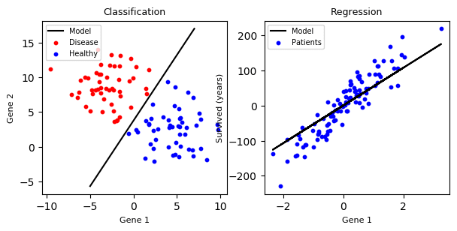
1.1 Regression vs Classification
Intuition: classification predicts a label and regression predicts a quantity.
Classification algorithms provide a decision boundary separating the data into N different categories and a trained model returns a label for a data point.
Regression algorithms provide a function or matrix that approximates an underlying distribution from which a bunch of data is drawn.
Source: https://dev.to/petercour/machine-learning-classification-vs-regression-1gn
Notes:
Talk more about the regression stuff. Give the intuition.

Slide 6
1.2.1 Basic Model Training I
ML models are often trained iteratively. A cost function is minimized until convergence.
Training is considered unsuccessful if error is too high.
Also makes sense to test on unused data to see if model works.
So we divide data into three sets:
Training set: The sample of data on which the model is trained.
Validation Set: The sample of data on which current set of hyperparameters are tested.
Test Set: The sample of data on which final model is tested.
The median train/val/test split is around 70/15/15 but opinions vary on this and different tasks may require different splits.
Notes:
Talk more about the regression stuff. Give the intuition.

Slide 7
1.2.2 Basic Model Training II
Where would the error occur in context of data and modelling?
Underfitting
The algorithm did not learn as much as it could have from the training data.
Why? The model was not powerful enough to model the data.
How to check for it? Training and validation error will both be high.
How to resolve it? Use a more powerful model. For example, if you are using a linear model, try using a nonlinear one.
Overrfitting
The algorithm paid too much attention to training data idiosyncrasies and now the final model won’t generalise.
Why? The model was too powerful for the data or there wasn’t enough data.
How to check for it? Training error will be very low but validation error will be high.
How to resolve it? Use a less powerful model or get more data (better choice).
Notes:
Talk about the statistical perspective to them

Slide 8
1.2.3 Basic Model Training III
Confusion Matrix
Notes:
Should I add the confusion matrix stuff?

Slide 9
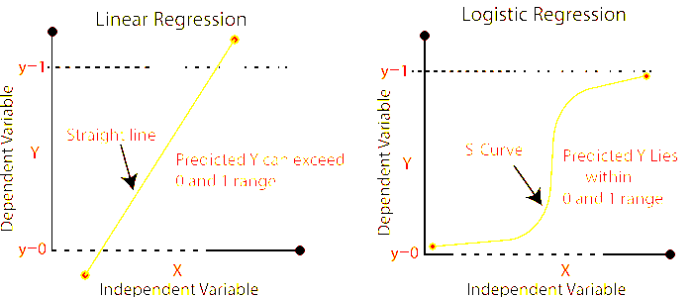
2. Linear Models

Slide 10

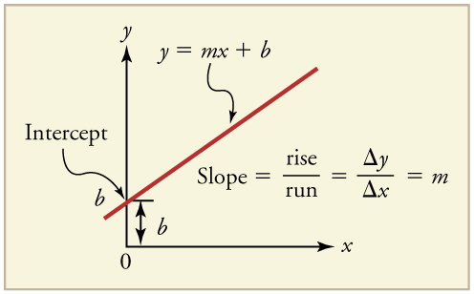
2.1.1 Linear Regression I
Intuition: Fitting a line through a series of points.
For enough values of y and x, m and b can be calculated, and using m, b, and new values of x, new values of y can be obtained.
What if x is multidimensional? Then for each x₁, x₂...x_{n} in x, we can have m₁, m₂...m_{n} and use matrix multiplication to get the values of m and b.
This is computationally expensive and requires a lot of data.
https://archive.cnx.org/contents/20986bfa-2c2a-47f1-a48a-786122b0c606@3/graphical-analysis-of-one-dimensional-motion
Notes:
Talk more about the regression stuff. Give the intuition. The intuition can exist for univariate data, but the concept can be mapped to N dimensions

Slide 11
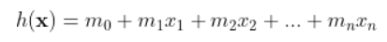
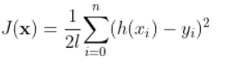
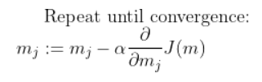
2.1.2 Linear Regression II
What do we do about the computational complexity of multivariate regression?
Iterative methods! Gradient descent can be used to obtain the value of m we are looking for.
We only have to worry about selecting J (c0st function), the number of iterations, and the value of ɑ (learning rate).
To learn more about linear models, check out Ch 3 of ESLII.
Notes:
Talk about GD and how it is computationally less expensive than matrix multiplication

Slide 12

2.1.2.1 Iterative Linear Regression Visualization
Notes:
Talk about GD and how it is computationally less expensive than matrix multiplication

Slide 13
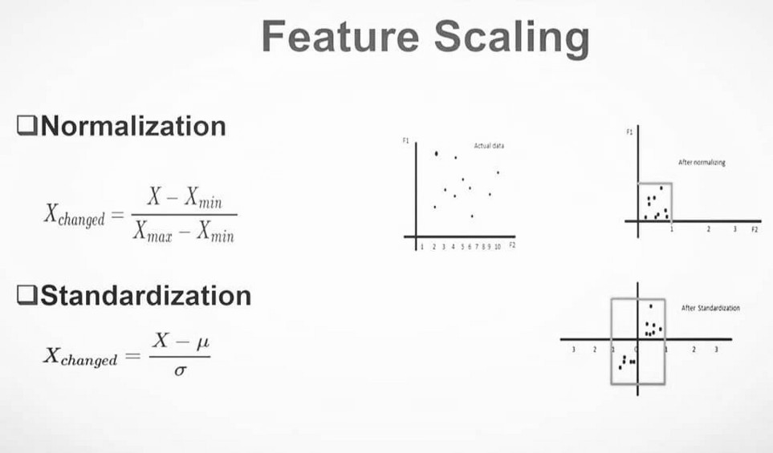
2.1.3 Linear Regression III: Tips & Tricks
Two standard techniques are used to improve performance:
Scaling: Data can be in wildly different scales and trying to model raw data will often lead to inferior performance.
Solution: Scaling
Normalization: Scaling each feature to range [0,1] (useful for logistic regression as well)
Standardization: Scaling each feature to [-1,1]
Source: https://medium.com/analytics-vidhya/need-and-types-of-feature-scaling-101ac2fc3af0
Notes:
Talk about GD and how it is computationally less expensive than matrix multiplication

Slide 14
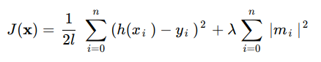
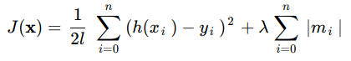
2.1.3 Linear Regression III: Tips & Tricks: Contd
Overfitting is often more challenging than underfitting.
If models are already simple and no more data is available, we use regularization.
Regularization shrinks the weights towards zero by applying a weighted (by a hyperparameter usually denoted by ƛ) penalty term to cost function.
Lasso regression (L1) applies a linear penalty term to the cost function.
This can set the weights for some features to 0.
It can be useful as a feature selection mechanism.
Ridge regression (L2) applies a quadratic penalty term to the cost function.
This will keep all the weights low, leading to a smoother error surface.
Notes:
Get into why overfitting is bad, and how important a tool regularization is.

Slide 15
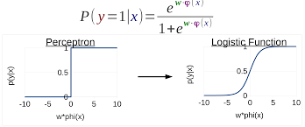
2.2.1 Linear Classification I
Intuition: What if we want to use a linear model for binary classification?
We can do it the following way:
Think of the output (y) having only two values: 0, and 1
The predicted output (ŷ) can be within a range of [0,1]
We can apply a decision boundary such that if ŷ is greater than it, it equals 1 (perceptron) or where the value of ŷ indicates the probability of it equalling 1 (logistic regression).
Decision boundaries can be linear (perceptron) or nonlinear (logistic regression).
Source: http://www.cs.umd.edu/class/fall2017/cmsc723/slides/slides_04.pdf
The function described at the top of the graphic is the sigmoid function, a popular nonlinearity used due to its excellent properties wrt differentiation.

Slide 16
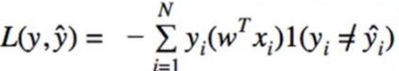
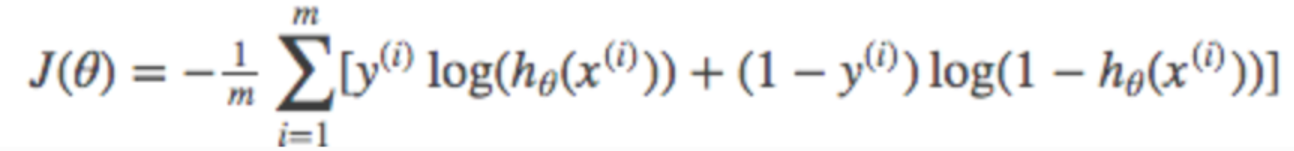
2.2.2 Linear Classification II: Cost Functions
Training for classifiers is quite similar to training for regression models as both use GD. However, classifiers use different cost functions.
Perceptron
The zero-one cost function
Where 1(true) =1 and 1(false) = 0
This means that only the data points that cause a misclassification will contribute to the error.
If the data is linearly separable, this loss will always converge.
Logistic Regression
The cross-entropy cost function
This cost function will lead to softer boundaries than the perceptron.
It can account for uncertainty, making it more robust.
It can converge for non-linearly separable data as well.
Notes:
Talk about the importance of cost functions and say that both these methods can be optimized by GD.
Get into what each cost function means.

Slide 17
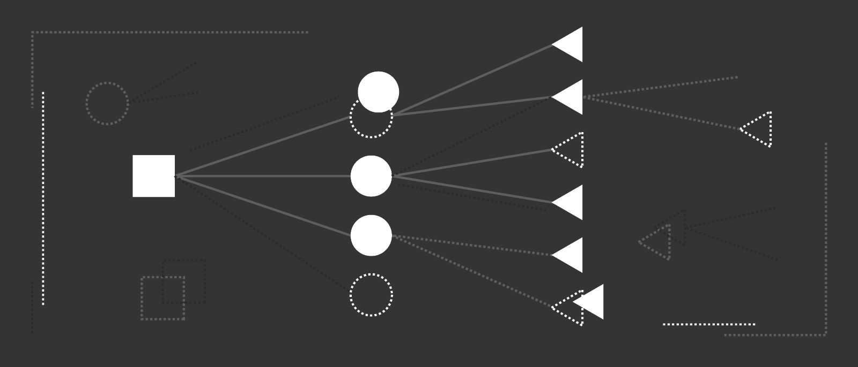
3. Decision Trees

Slide 18
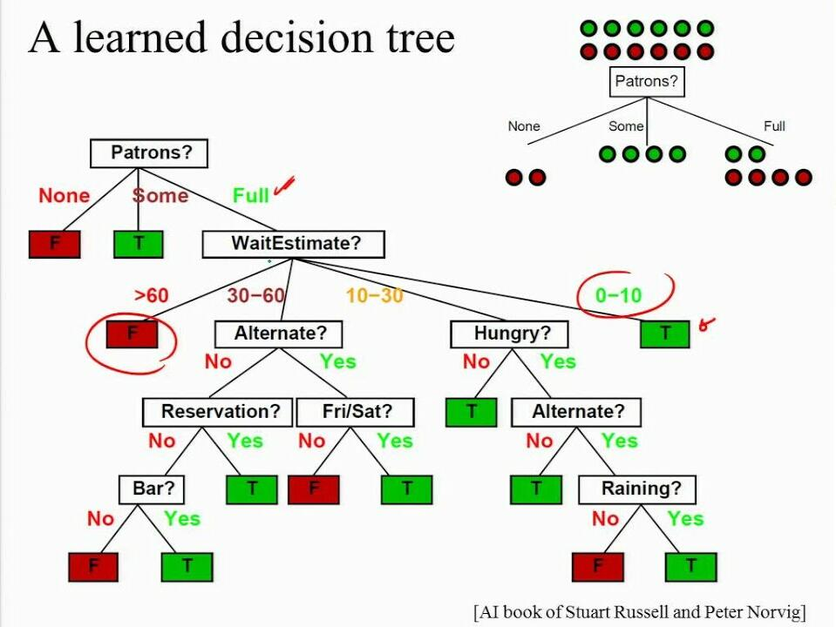
Why Decision Trees?
Decision trees are very interpretable as seen in the image.
This is desirable in a lot of domains such as medicine, banking, law, etc.
Learning and using them is computationally efficient.
Good predictive accuracy, which only gets better with ensembling.

Slide 19
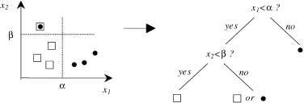
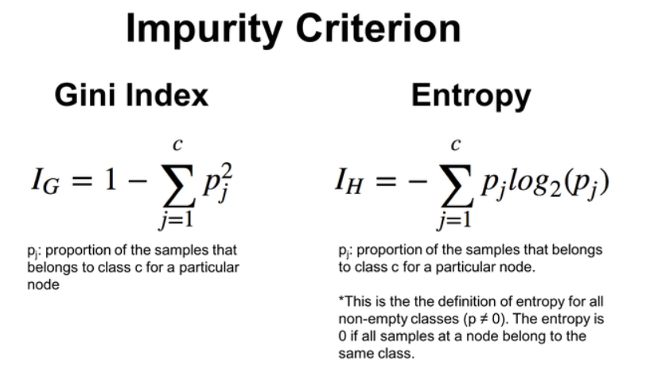
3.1 Decision Tree Training
Intuition: Training basically involves asking a series of questions about each feature.
Each data-point can be considered a path with the y as the leaf node.
Pass enough of those through the training process and the tree will develop a notion of which conditions offer the best “split”.
How do we decide which split is the best?
GINI coefficient (CART)
Using Information Gain (ID3 and the more powerful C4.5)
Notes:
Talk about GINI and entropy

Slide 20
3.1 Decision Tree Training
Intuition: Training basically involves asking a series of questions about each feature.
Each data-point can be considered a path with the y as the leaf node.
Pass enough of those through the training process and the tree will develop a notion of which conditions offer the best “split”.
How do we decide which split is the best?
GINI coefficient (CART)
Using Information Gain (ID3 and the more powerful C4.5)
Notes:
Talk about GINI and entropy

Slide 21
3.2 Decision Tree: Overfitting
It is easy to imagine a scenario where a decision tree splits for each data point.
This would make it massively overfitted to the training data and unlikely to generalise.
How to avoid it?
Cautious splitting of a node: Do not split a node unless you are certain that the split is meaningful
Post-pruning (highly effective but a strain on performance): Once the (large) tree has been built, prune away branches that turned out not to contribute much
Decision Tree Resources: [1], [2]
Notes:
Talk about GINI and entropy

Slide 22
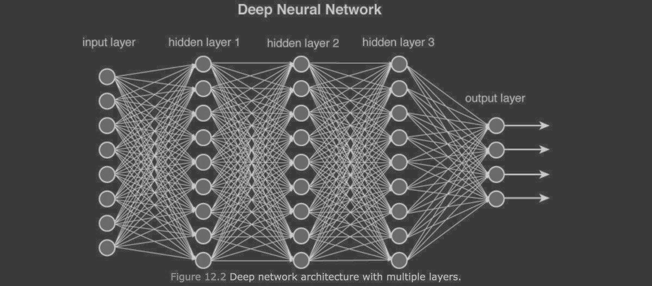
4. Why Not Deep Learning?

Slide 23
4.1 What makes NNs awesome?
Neural networks are an immensely powerful tool in a lot of cases.
They can represent various kinds of data and perform inference in cases where explicit modelling is almost impossible.
Using NNs as approximators usually boosts a lot of traditional algorithms too. Adversarial modelling, Q-learning, etc. were all boosted significantly when combined with neural networks.

Slide 24
4.2 So why not use them?
They require a tonne of data. This, or the lack of it, can hamper performance and result in a less reliable product.
They require specialised hardware (GPUs/TPUs) if we have any hope of running them fast. Those are expensive and training times can be immensely high depending on task complexity, adding to the costs.
NN training is analytically weak. There is no definitive proof for why the Adam optimizer [3] works so well, why the ReLU activation [4] outperforms all the others, why overparameterized networks [5] perform so well.
Most importantly, Neural Networks Are Not Interpretable/Explainable..
This is a major cause of concern in a lot of industrial contexts such as medicine, banking, law, etc.

Slide 25
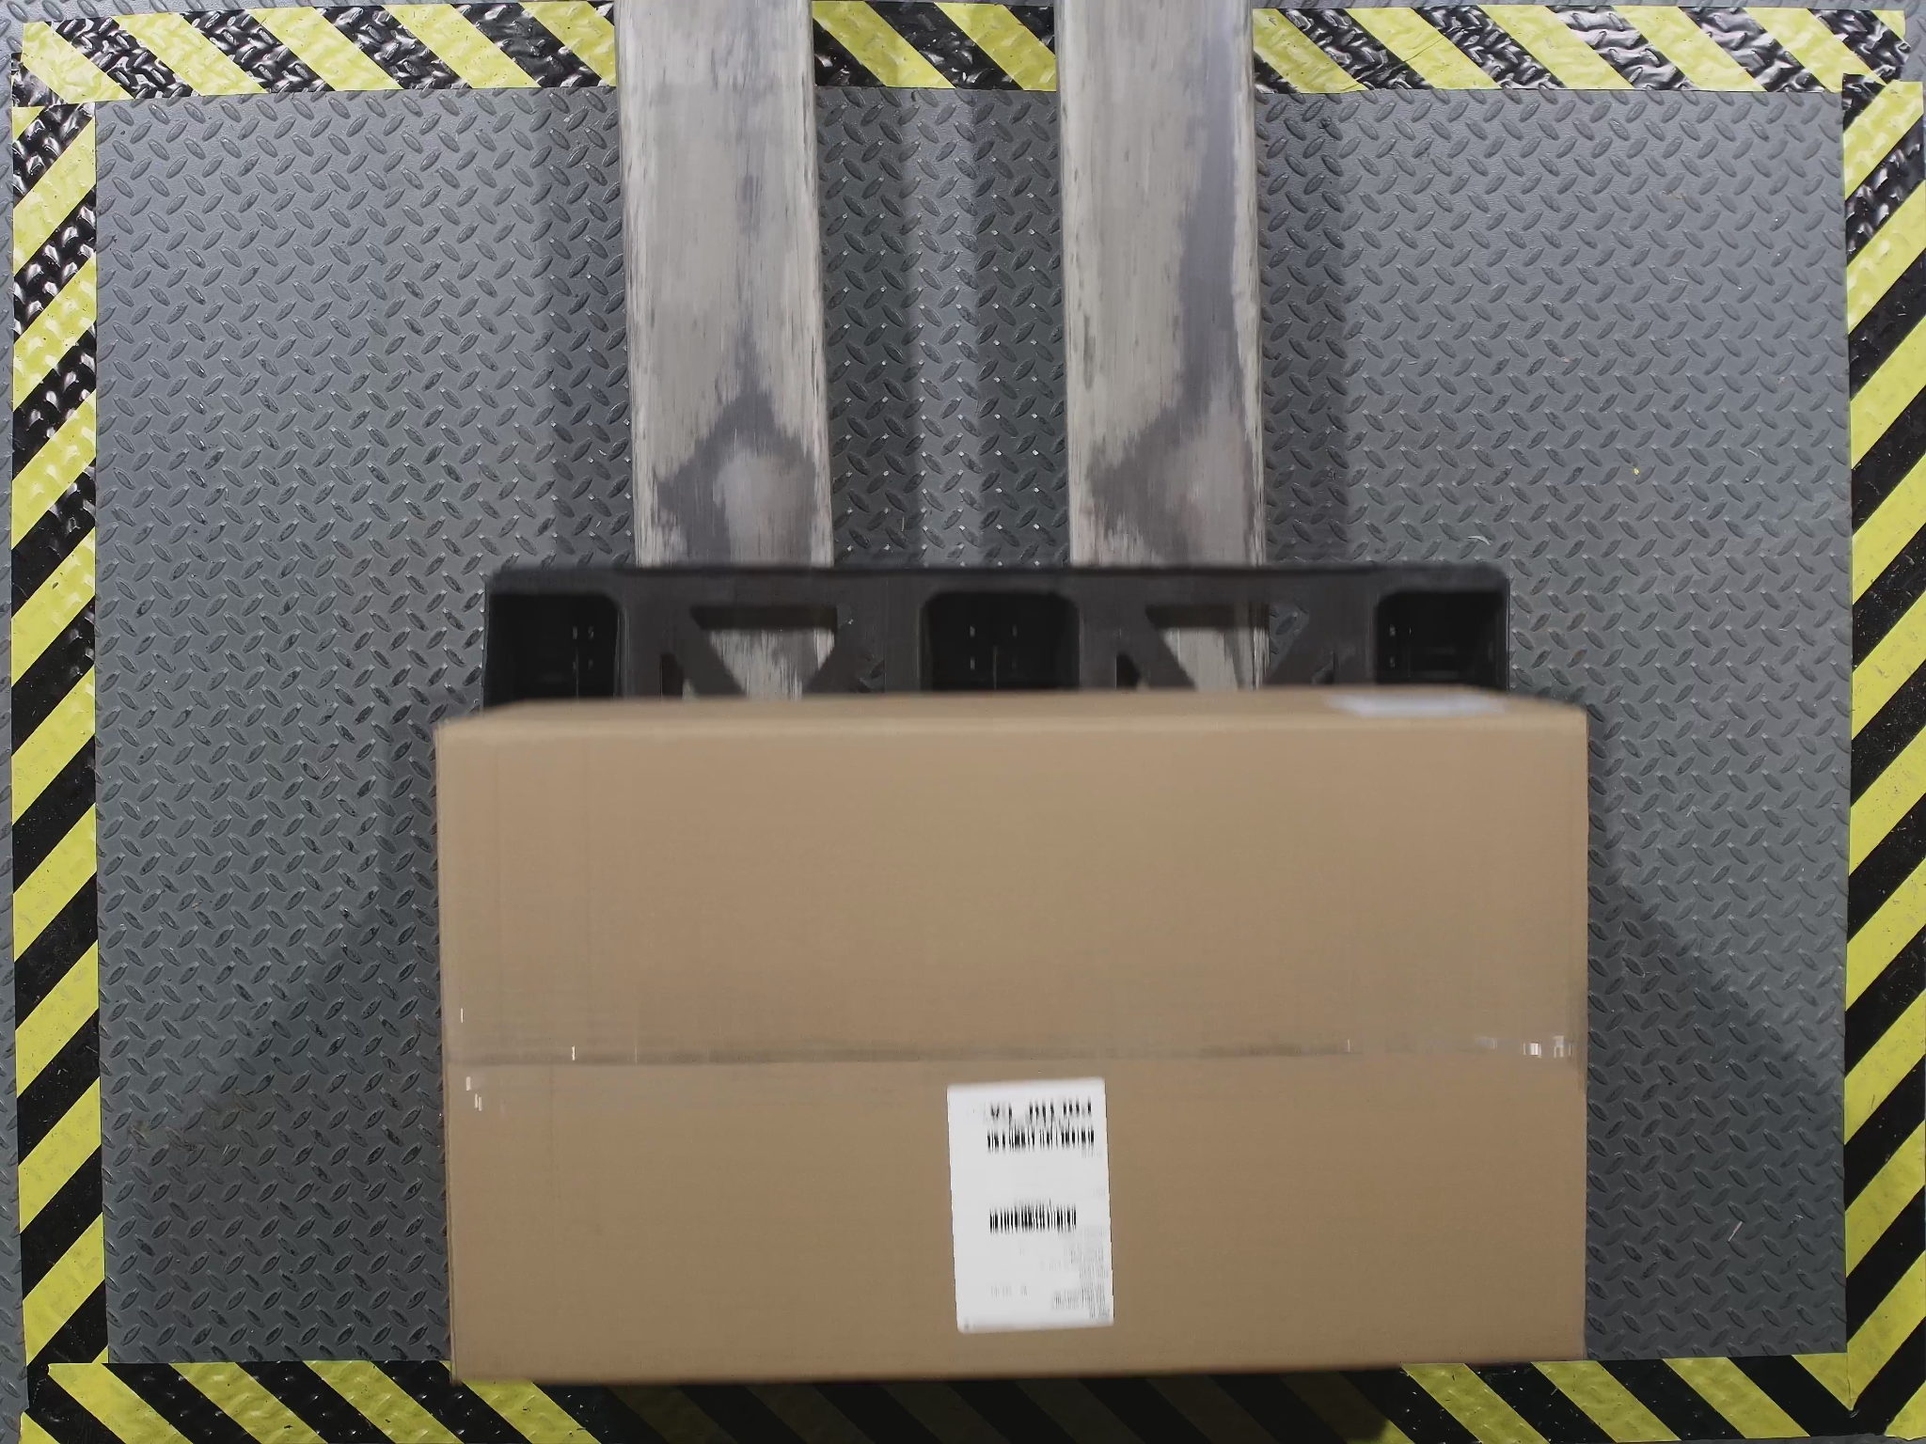
4.3 An Example
A few months ago, we had a computer vision (a domain where deep learning has really shone) use-case where we could not use deep learning due to various requirements
Real-time inference
Little data
On-prem inference (no GPUs)
We used classic CV algorithms and met all three requirements.
Notes:
Talk about the limited semantic complexity

Slide 26
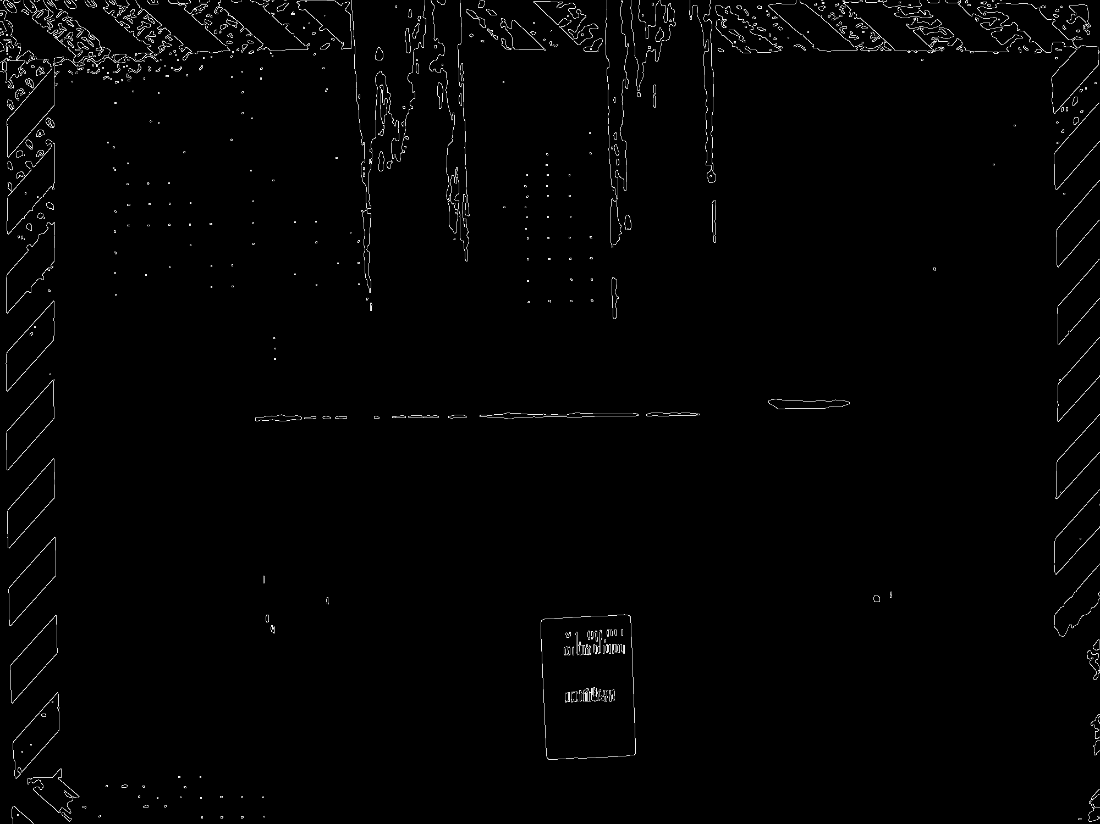
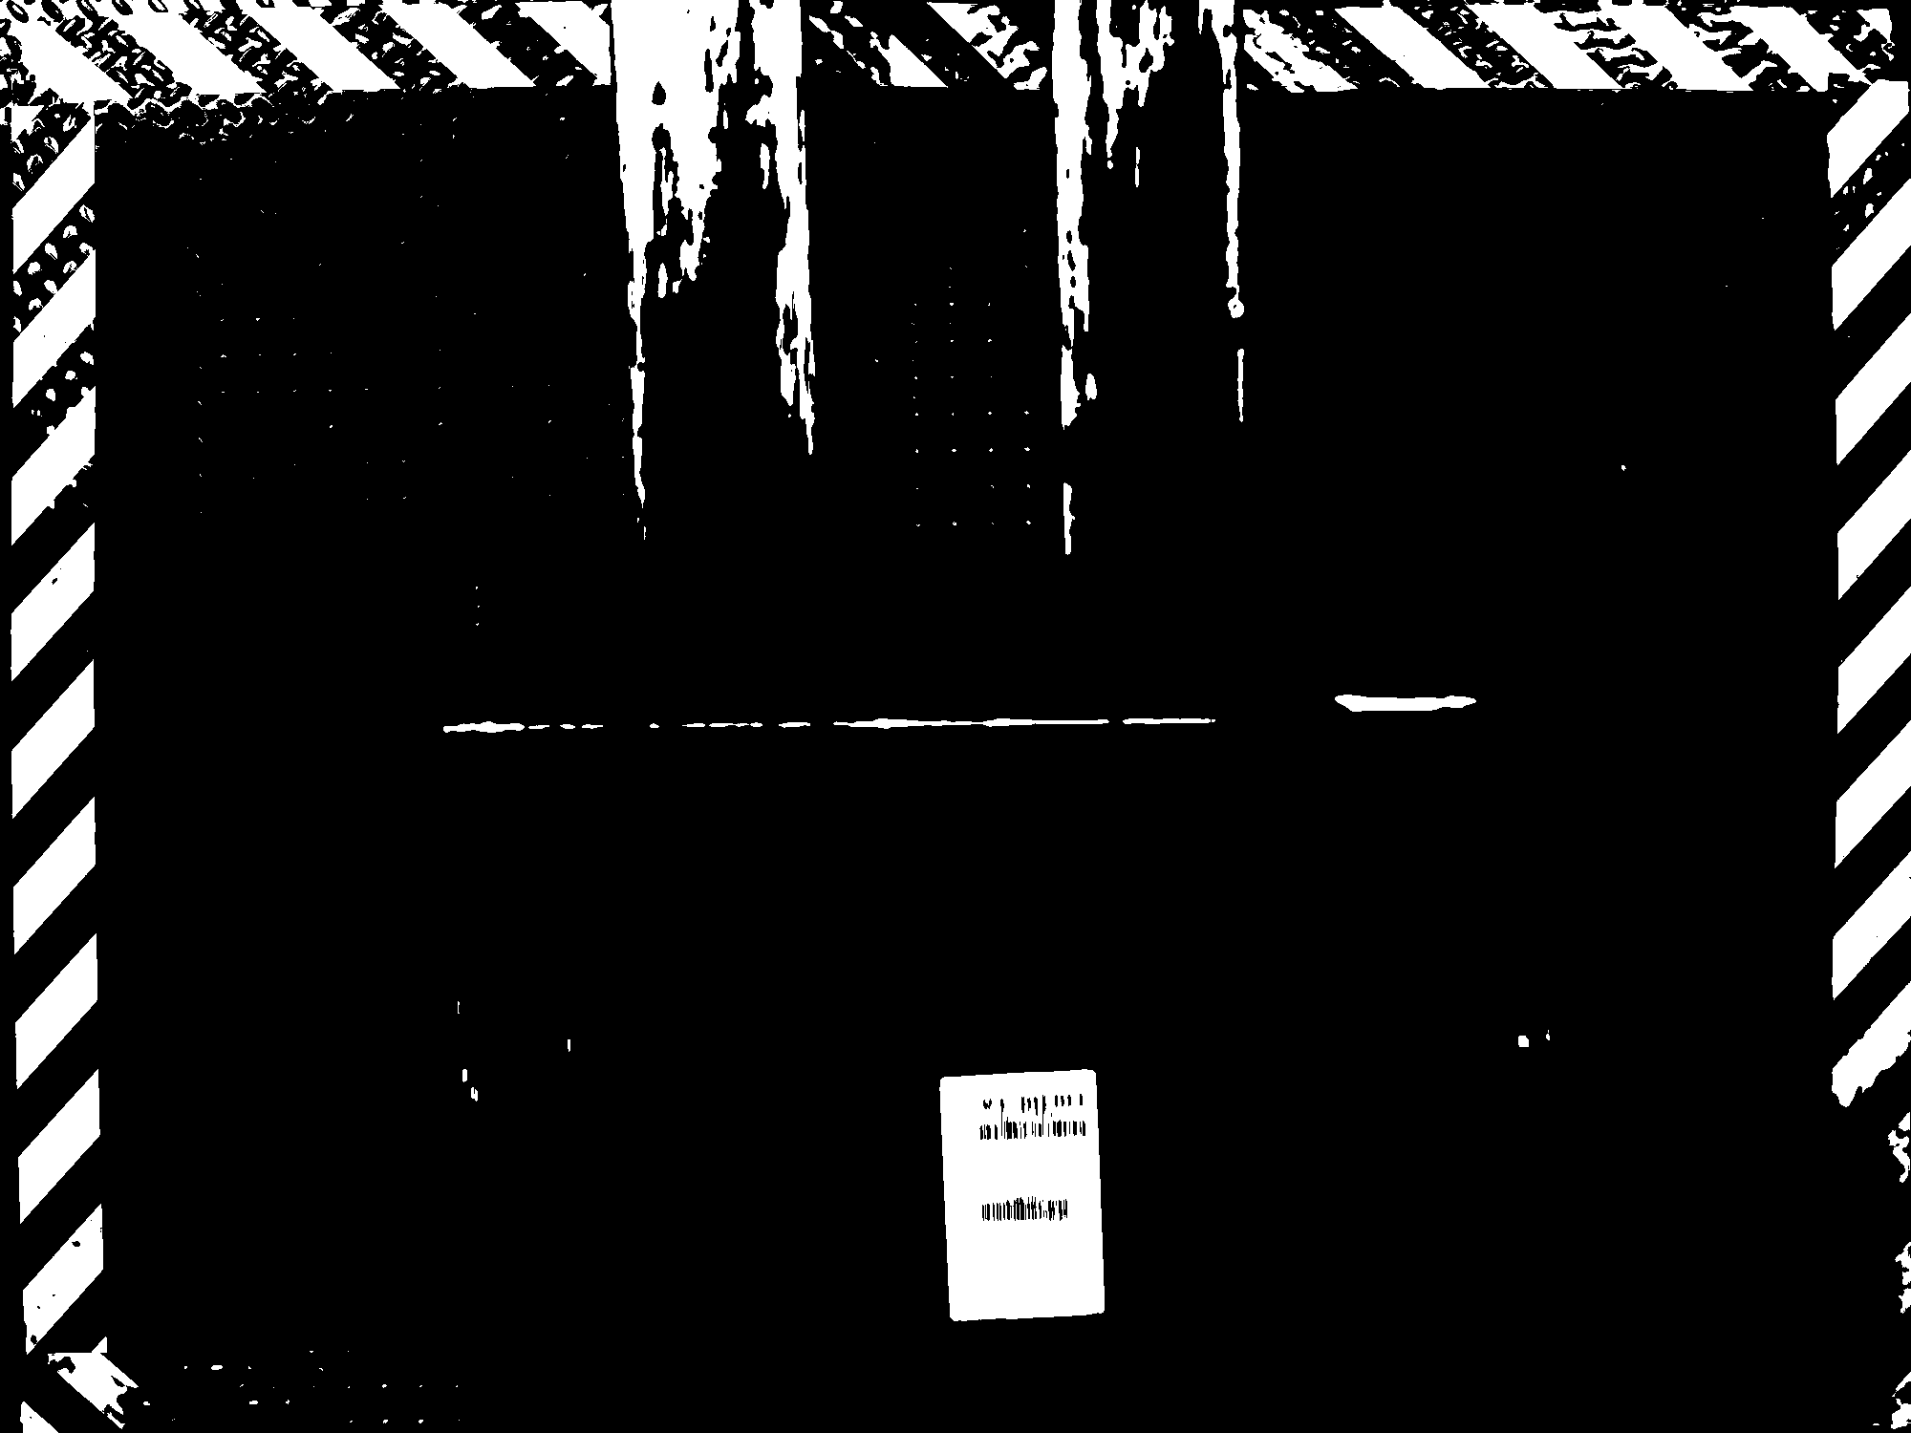
We had to obtain the labels in each case.
With some feature engineering and interpretable CV algorithms, the task proved quite easy.
Since ML isn’t a major part of this pipeline, limited data was required.
The algorithms could perform near-real-time even on a CPU
We could clearly separate the label contours and extract them as seen in these pictures.

Slide 27
4.4 The Point (Finally)
In a lot of industrial contexts, you will get problems that don’t have clean and abundant data, easy access to powerful hardware, and/or severe efficiency requirements.
Robustness, interpretability, deployability, and speed are often worth losing a percentage point or two of accuracy.
Because of this, the algorithms discussed above and variants of them (Random Forests, Generalised Linear Models, other ensembles) will often be the favoured solution in a lot of cases.

Slide 28
Now let’s begin the fun part of the workshop.
Let’s talk about the case.
Thanks.

